Slide 1
HTML5 Introduction
Prof Maheswari S,
VIT Chennai

Slide 2
HTML?
HTML – Hyper Text Markup Language

Slide 3
Introduction
HTML - Developed with the intention of defining the layout of files such as headings, paragraphs, lists, and so on
To encourage the exchange of scientific facts between researchers

Slide 4
Why we need to use?
To format net pages
MUST for students and working professionals to operate in the Web Development Domain
Need to understand HTML to deliver the first rate results.

Slide 5
Benefits
Can create a Web site only with html
Web Understanding
Interoperability
Search ability
High performance
Responsive
Notes:
Web Understanding - To customize your website with its increasing speed and efficiency.

Slide 6
Basics in HTML5
Structure based language
Head and body tags
- Can include title and links of CSS
Comments and doctype
Tags, Elements and Attributes

Slide 7
Paired Tags
A tag is said to be a paired tag if the text is placed between a tag and its companion tag.
In paired tags, the first tag is referred to as Opening Tag and the second tag is referred to as Closing Tag.
Example:
<p>Paragraph</p>

Slide 8
Unpaired Tags
An unpaired tag does not have a companion tag. Unpaired tags are also known as Singular tags or Stand-Alone Tags.
Example:
<br>
<img src='test.png' >

Slide 9
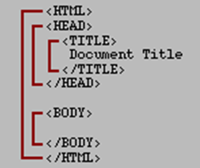
Structure of HTML document
Basic structure:

Slide 10
Example

Slide 11
Attributes
Tags have their own attributes
The below table shows BODY tag attributes
Attribute | Value
background | URL
bgcolor | color
text | color
link | color
vlink | color
alink | color
Example:
<body bgcolor = “black”>
Obsolete in HTML5, use CSS instead

Slide 12
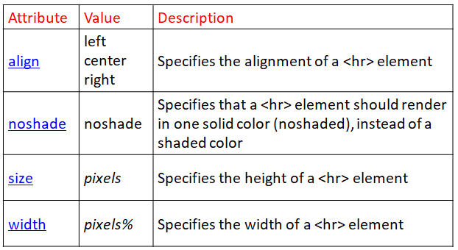
HR tag
Obsolete in HTML5, use CSS

Slide 13
Meta tag
Written in head tag
Mainly used for SEO
Example:
<meta charset = “utf-8”>
<meta name = “description” content = “VIT university, Chennai”>

Slide 14
Heading tags (h1..h6)

Slide 15
Text Formatting tags
<b> - bold
<i> - italic
<u> - underline
<small> - to make a text in small
<big> - to make a text in big
<sub> - subscript
<sup> - superscript
<mark> - defines marked or highlighted text
<q>…</q> - quotation
<address>

Slide 16
Text Formatting - Example
<!DOCTYPE html>
<html>
<head>
<meta charset="utf-8">
<title>Text Formatting Example</title>
</head>
<body>
<b>Text</b>
<i>Text</i>
<u>Text</u>
<small>Text</small>
<big>Text</big>
<sub>Text</sub>
<sup>Text</sup>
</body>
</html>
Output :

Slide 17
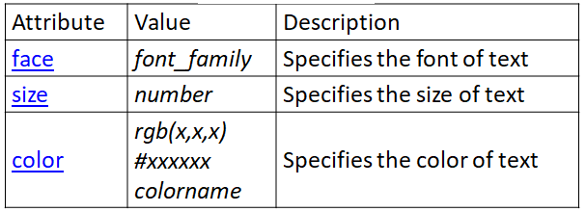
Font tag
Obsolete in HTML5, use CSS instead

Slide 18
Inserting Symbols
Result | Description | Entity Name
₹ | rupees | &#8377;
¢ | cent | &cent;
£ | pound | &pound;
¥ | yen | &yen
€ | euro | &euro;
§ | section | &sect;
© | copyright | &copy;
® | registered trademark | &reg;
space | non-breaking space | &nbsp;
18

Slide 19
Break
<br> Inserts a single line break
<wbr> (Word Break Opportunity) defines a possible line-break

Slide 20

acronym
Can I get this <acronym title="As Soon As Possible">ASAP</acronym>?

Slide 21
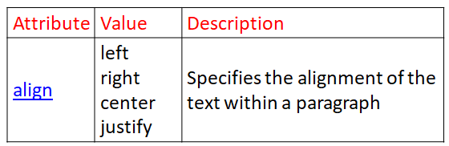
Text Containers
<p>
<pre>
defines preformatted text

Slide 22
Div tag
<html>
<head></head>
<body>
<div >
<a href="www.chennai.vit.ac.in"
title="VIT Chennai"> VIT Chennai</a>
<a href="www.vit.ac.in"
title="VIT Vellore">VIT Vellore</a>
</div>
</body>
</html>

Slide 23
Anchor
<a>
<a href = “indiancoders.com”>Link Text</a>
<a href = “home.html”>Home</a>
Link to a paragraph
<p name=“pname”>….</p>
<a href="#pname">A simple link</a>
mailto
<a href="mailto:someone@microsoft.com">

Slide 24
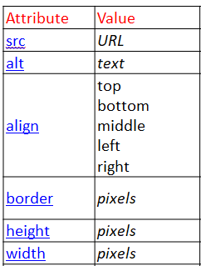
Image
<img>
<img src="D:\FALL 20-21\CSE3002
IWP\userprofile.png" alt="profile"
align="center">
Example: Ex4_CommonlyUsedTags.html

Slide 25
Marquee
<marquee width=“70%” direction=“up” height=“50px“ loop=5 bgcolor=“blue”> Marquee Text Content </marquee>
Direction can be: left, right, up or down
Obsolete in HTML5, use CSS instead

Slide 26
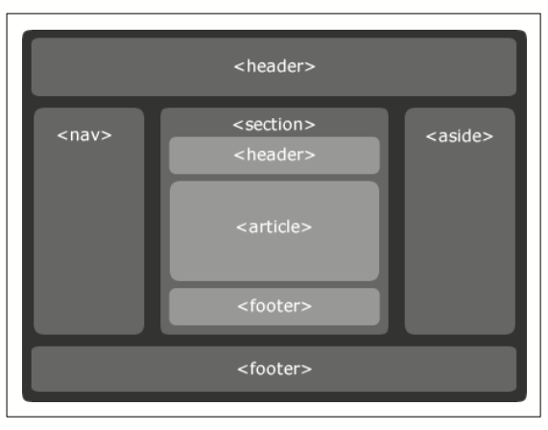
Layout

Slide 27
Semantic Tags
<article> - article in the element
<header> - header for the section or article
<footer> - footer for the section or article
<section> - section in the document
<aside> - content aside from the page content
https://www.w3schools.com/tags/tag_article.asp

Slide 28
Example: <nav>
<nav>
<a href="/html/">HTML</a> |
<a href="/css/">CSS</a> |
<a href="/js/">JavaScript</a> |
<a href="/jquery/">jQuery</a>
</nav>

Slide 29
Other Semantic Tags
<progress> - progress of a task
<meter> - scalar measurement with in a known range
Progress in life goals (70%)
<progress min=0 max=100 value=70></progress>
Life goals achieved (50%)
<meter min=0 max=100 value=50></meter>

Slide 30
Semantic Tags
https://www.w3schools.com/tags/tag_dialog.asp
<dialog> defines a dialog box or window
<figure> - self contained content like diagram
<figcaption> defines the caption for a <figure>
https://www.w3schools.com/tags/tag_figure.asp

Slide 31
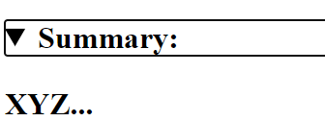

Semantic Tags
<details> defines additional details that people can view or hide (like a tooltip)
<summary> defines a visible heading for a <details> element
<details>
<summary>Summary:</summary>
<p>XYZ...</p>
</details>

Slide 32
Semantic Tags
<menu> defines a list/menu of commands.
<menuitem> defines a command/menu item that the user can select from a popup menu. Work only in firefox.
<bdi> (Bi-Directional Isolation) defines a section of text that might be formatted in a different direction from other text (for instance, a quote in Hebrew or Arabic in an otherwise-English article)
<time> defines a date/time
https://www.w3schools.com/tags/tag_menu.asp

Slide 33
Thank you

